Slide 1
Introduction To Internet
Chapter One

Slide 2
What is the internet
Internet is a global system of interconnected computer networks that use the standard Internet protocol (often called TCP/IP) to serve billions of users worldwide. It is a network of networks that consists of millions of private, public, academic, business, and government networks, of local to global scope, that are linked by networking technologies.

Slide 3
History of the internet
the history of the Internet begins with the development of electronic computers in the 1950s.
The US Department of Defense awarded contracts as early as the 1960s, including for the development of the ARPANET project.
The first message was sent over the ARPANET in 1969 from computer science laboratory at University of California, Los Angeles to the second network at Stanford Research Institute (SRI).

Slide 4
Who Owns the Internet?
There are many organizations, corporations, governments, schools, private citizens and service providers that all own pieces of the infrastructure, but there is no one body that owns it all. There are, however, organizations that oversee and standardize what happens on the Internet and assign IP addresses and domain names, such as the National Science Foundation, the Internet Engineering Task Force, ICANN , InterNICand the Internet Architecture Board.

Slide 5
Internet Connections
There are many ways a personal electronic device can connect to the internet. They all use different hardware and each has a range of connection speeds:
Dial-Up (Analog 56K).
DSL
Cable
Wireless
Satellite
Cellular

Slide 6
1.Dial-Up
Dial-up access is cheap but slow.
A modem connects to the Internet after the computer dials a phone number.
This analog signal is converted to digital via the modem and sent over a land-line serviced by a public telephone network.
Telephone lines are variable in quality and the connection can be poor at times.
The lines regularly experience interference and this affects the speed.
Since a computer or other device shares the same line as the telephone, they can’t be active at the same time.
Speed: 28K to 56K

Slide 7
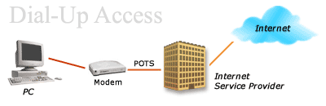
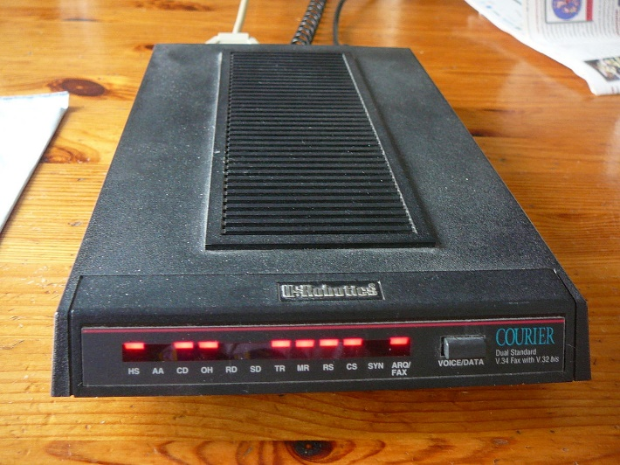

Slide 8
2. DSL
DSL stands for Digital Subscriber Line.
It is an internet connection that is always “on”.
uses 2 lines so your phone is not tied up when your computer is connected.
There is also no need to dial a phone number to connect.
DSL uses a router to transport data.
Speed: 128K to 8 Mbps

Slide 9
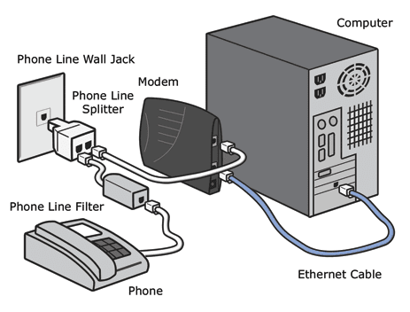

Slide 10
3. Cable
Cable provides an internet connection through a cable modem and operates over cable TV lines.
There are different speeds depending on if you are uploading data transmissions or downloading.
The coax cable provides a much greater bandwidth over dial-up or DSL telephone lines.
Speed: 512K to 20 Mbp.

Slide 11
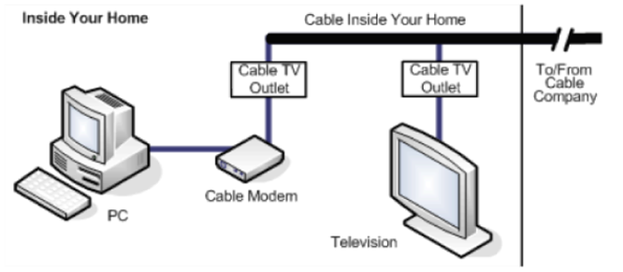
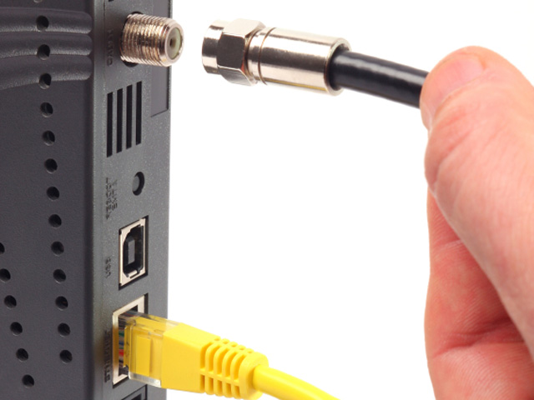

Slide 12
4. Wireless
Wireless, or Wi-Fi, does not use telephone lines or cables to connect to the internet.
It uses radio frequency.
Wireless is also an always on connection and it can be accessed from just about anywhere.
Speed: 5 Mbps to 20 Mbps.

Slide 13
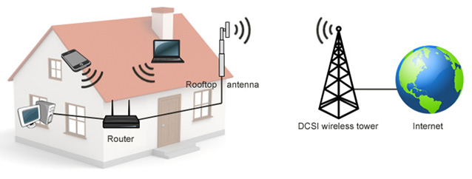

Slide 14
5. Satellite
Satellite accesses the internet via a satellite in Earth’s orbit.
The enormous distance that a signal travels from earth to satellite and back again, provides a delayed connection compared to cable and DSL.
Speed: 12K to 2.0 Mbps

Slide 15
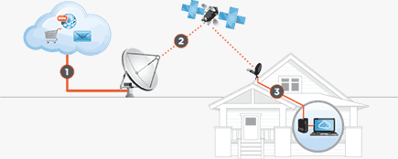

Slide 16
6. Cellular
Cellular. Cellular technology provides wireless Internet access through cell phones. The speeds vary depending on the provider, but the most common are 3G and 4G speeds. A 3G is a term that describes a 3rd generation cellular network obtaining mobile speeds of around 2.0 Mbps. 4G is the fourth generation of cellular wireless standards. The goal of 4G is to achieve peak mobile speeds of 100 Mbps but the reality is about 21 Mbps currently.

Slide 17
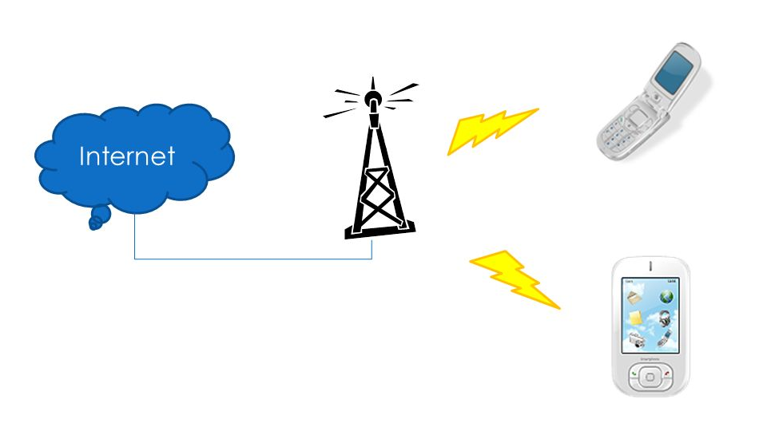

Slide 18
Advantages of the Internet
you can send and receive e-mails
you can get in touch with your friends
you can do shopping
you can downloads files, music and films
you can find interesting materials
you can meet/get to know a lot of people
you can find flat or jobs quickly
the net is easy and fast source of information
the net makes our work easier
the net enables us to do shopping, pay bills without leaving our homes
the net saves our time (we don’t have to stay in queue)
provides entertainment
And much more…..

Slide 19
Disadvantages of the Internet
Although the Internet is one of the greatest creations, it also has many disadvantages. Because the internet is easily accessible to anyone, it can be a dangerous place. You have to know who you're dealing with or what you're getting into. Predators, cyber criminals, bullies, and corrupt businesses will try to take advantage of the unwary visitor.

Slide 20
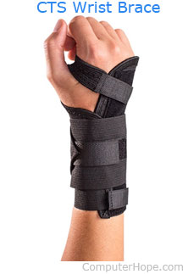
Disadvantages of the Internet
Bullying, trolls, stalkers, and crime
Exploitation and pornography and violent images
Addiction, time waster, and causes distractions
Never being able to disconnect
Identity theft, hacking, viruses, and cheating
Spam and advertising
Depression, loneliness, and social isolation
Health issues and obesity
Buying things not needed
https://www.computerhope.com/issues/ch001810.htm

Slide 21
Electronic Communication Theory
This theory emphasized the technical problems of transmitting a message from a sender to a receiver.
It is based on, and uses the language of, electronics.
The message begins with an information source, the mind of the sender (writer or speaker), who encodes a message into words and sentences.
The message is transmitted as signal (text on paper or sound waves) through a channel, where it may be distorted by noise (such as smudged typing or acoustical problems).
The receiver (listener or reader) decodes the message

Slide 22
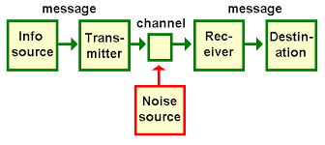
Communication Model

Slide 23
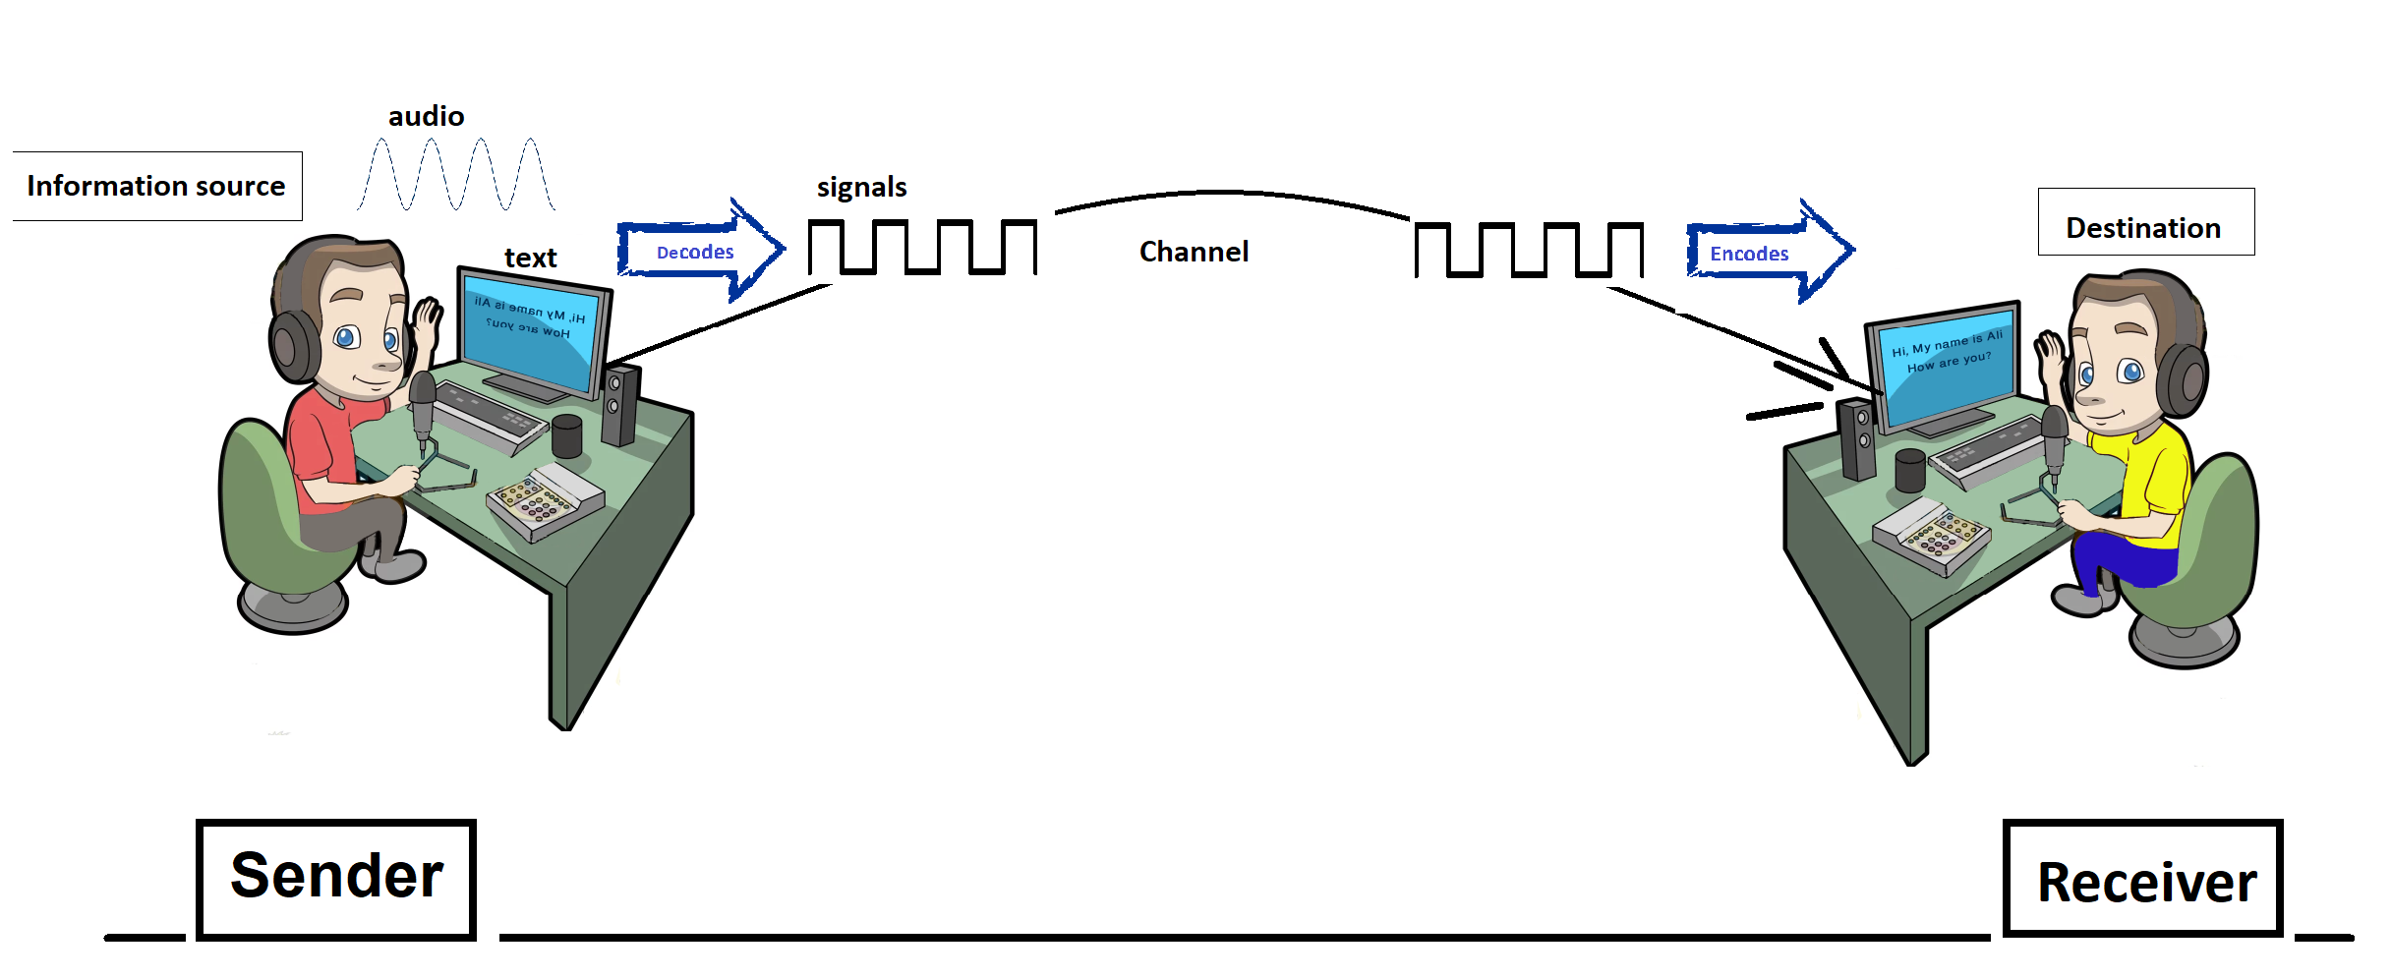
Communication Model
Noise

Slide 24


